Slide 1
Much Ado About Nothing
A Valued Based Physician Approach to HCC Coding
© 2023 ChenMed, LLC

Slide 2
Learning Objectives
Define and understand HCC/RAF Coding as opposed to CPT/RVU Coding.
Describe how HCC Codes are captured and reported.
Understand the impact of precision and timing
of HCC Codes.
A working familiarity with most common HCC Codes and most common under-reported HCC codes.
1
2
3
4
2
© 2023 ChenMed, LLC

Slide 3
Complexity
Notes:
Going to discuss the difference in Fee For Service Complexity and Value Based Care Complexity.

Slide 4
Complexity
Service-CPT
Patient-HCC
Depression
CHF
CKD
4
© 2023 ChenMed, LLC
Notes:
FFS/CPT is related to the complexity of the episodic visit or service.
Value Based Care/HCC coding is the complexity of the patient over the course of a year.

Slide 5
Risk
Notes:
Quick Mention of what is Risk and Why it needs to be adjusted.

Slide 6
Medical Risk
Sicker patients use more services and therefore are “riskier.”
Healthy
Costs less
Sick
Costs more
6
© 2023 ChenMed, LLC
Notes:
Pretty simple– sicker patients cost more to take care of and if you are responsible for paying for their care they are “riskier”

Slide 7
What is Medical Risk Adjustment – Why is it Important?
Healthy
Sick
Risk Adjustment
7
© 2023 ChenMed, LLC
Notes:
In simple terms, Medical risk adjustment means you get paid more for taking care of sicker patients.
It is simpler than Nephrology, but just as ignoring how the kidney works, if you are going to move into value-based care you can’t ignore how Risk Adjusted coding works.

Slide 8

The Full Risk Value Based Care Business Model
Show me
the money
What’s left in this bucket at the end of the year is what you get to keep.
Patients + Dx+ HCC/MRA
There’s a Hole in My Bucket!
The
Doctor Patient relationship
is the key to plugging…
Size of Hole Determined By:
Hospital/ED Costs- Part A.
Professional Fees- Part B.
Drugs- Part D.
8
© 2023 ChenMed, LLC
Notes:
“Top-line” Revenue is based on the number of patients and the complexity of each individual patient. (the money flowing into the bucket)
“Bottom-line” Margin (aka Profit)– is the Revenue, minus the cost of caring for the patient.– Part A hospital, Part B Outpatient and Professional Services, Part D drugs.
The relationship is key to help control those costs.

Slide 9





Medical Risk Adjustment On a Per Patient Basis
Health Status
Demographics
69k Possible
DX Codes (ICD 10)
9k Risk Adjust
79 CMS HCC Codes
Dual: Yes/No
Gender
Home vs. SNF/LTC
ESRD
RAF x Baseline = Adjusted Baseline
Resets Every Year
9
Notes:
The- Risk adjustment factor for each patient is the sum of the individual raf scores for each of their HCC codes that can be adjusted for living situation, dual vs non dual, ESRD, and more will be coming in the future.
It is calculated for each patient but depending on VBC model revenue may flow based on individual patient or be averaged over part or all of a population. (eg: by quintile in Primary Care First Model) Coding rubric is still the same.
RAF- Risk Adjustment factor for each HCC code.
Pt: Patient
Dx: Diagnosis
SNF: Skilled Nursing Facility
LTC: Long Term Care
ESRD: Patients on Dialysis

Slide 10
How To Communicate HCC Scores
DX
1
OR
2
3
4
Insurance
Carrier
CMS
1
Documenting on problem list helps but does not communicate to Insurance and CMS.
Be as specific as possible (HCC22, RAF 0.273).
Difference in obesity (No HCC score, RAF 0) versus morbid obesity = $2,600 For Year.
2
10
© 2023 ChenMed, LLC
Notes:
You have to communicate to the insurance company. While they ask for records all the time, they are not really looking at your problem list. The only communication that they recognize for HCC coding are the codes on the bills that you submit to them.
EG Morbid Obesity risk adjusts. So, If billed this year, next year in a risk adjusted world there is an extra $2600 to care for that patient.
A good day in primary care if you can add $2600 to the revenue for the year.
(this is assuming payment of $800 PMPM for RAF of 1.0– Not ChenMed numbers and probably undercounting now)

Slide 11

The Board is Wiped Clean Every Year
If you don’t document and communicate via a bill it goes away each year.
Amputated limbs grow back
COPD patients suddenly are cured
Patients are no longer diabetic
Kidneys all function normally
Everyone is no longer morbidly obese
Etc.
© 2023 ChenMed, LLC
Notes:
Note the codes reset on January first each year and payment runs a year behind.
EG in Medicare Advantage Risk contract.– code for Morbid obesity in 2023- get $2600 additional money in 2024 to care for patient/population, but if do not put the code on a claim in 2024, they magically lose weight and, you will not get that revenue in 2025.

Slide 12
Team Based Learning - Exercise
Notes:
Go through the tasks in the handout
One at a time
Then in a small group
Then as a large group.
1st– they come up with their answer
2nd—then they have to come up with a consensus in the small group (as the answers are ambiguous, this discussion helps make the teaching points) but insist that they come to an agreement in each group
3rd. Then facilitator asks for one groups answer– ask if anyone disagrees, and then discuss the sides of the ambiguity. (this is important to solidify teaching points)
After all tasks completed come back to finish slide presentation.

Slide 13
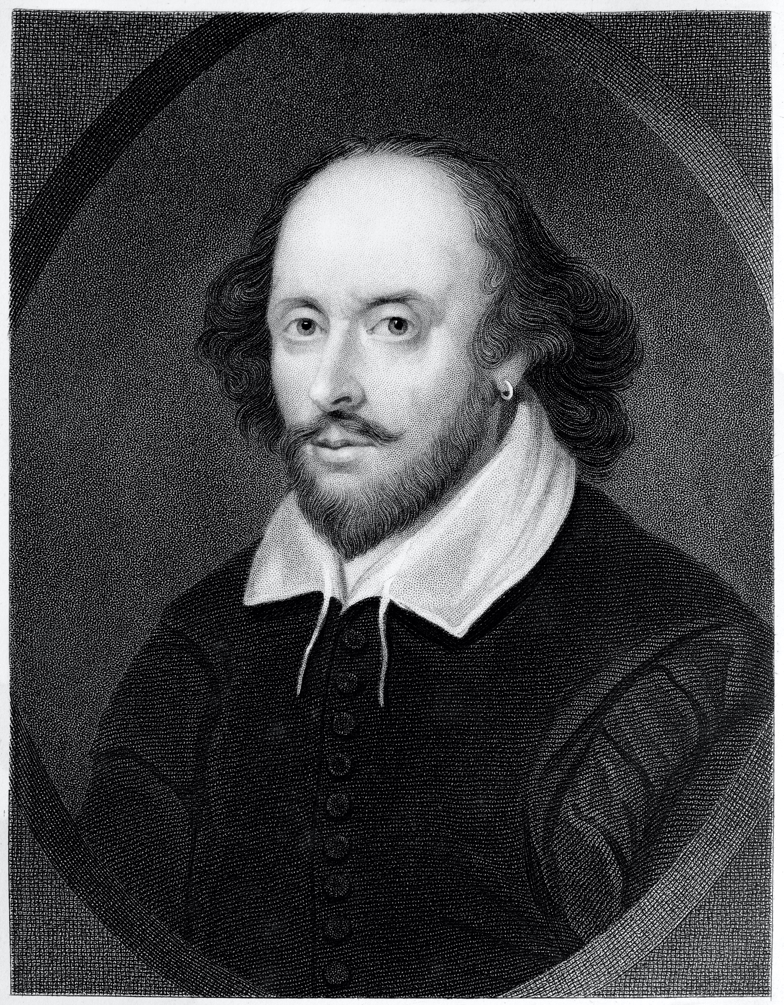
Much Ado About Nothing
Year
1
Year
2
Year
3
Absence of lower extremity noted
Amputation not noted
No diagnosis noted in Year 2
Limb must have grown back!
DX: 289.61
HCC: 0.519
Revenue: ------
DX: -------
HCC: ------
Revenue: $4982
DX: -------
HCC: ------
Revenue: $0!!!
13
© 2023 ChenMed, LLC
Notes:
This is showing how you make dx in one year, Get the revenue the following year, but if don’t code the second year—you lose the revenue the 3rd year. (limb grows back)
Yr 1– surgical absence of lower extremity noted (no revenue because not noted previous year)
Yr 2– Get Revenue from coding for year 1, but if don’t submit the code in year 2 then
Yr3– the limb has magically regenerated and you do not get the payment. (But you are still taking the risk)– someone who loses one limb is at risk of falls and likely at risk for losing another limb.

Slide 14
Every diagnosis code must be noted and billed
for every year or it will fall off the following year
82% of HCC codes come from primary care.
18% Specialists
and Facilities
82% Primary Care
© 2023 ChenMed, LLC
Notes:
Every diagnosis must be coded every year and over 80% of the codes come from Primary Care. (this is opposed to 93% of RVU’s being generated by hospitals and facilities)
Is primary care still a loss leader??????

Slide 15
Valid HCC Coding Requires
Face to Face Visit (video counts)
Status or Condition
Plan of Action
M.E.A.T– documentation mnemonic
M: Monitor--signs, symptoms, disease progression,
disease regression
E: Evaluate--test results, medication effectiveness,
response to treatment
A: Assess/Address--ordering tests, discussion,
review records, counseling
T: Treat--medications, therapies, other modalities
15
© 2023 ChenMed, LLC
Notes:
Also be careful about copy forward.

Slide 16
Do Not Code Non-Definitive Conditions
Don’t use:
  Probable
  Possible
  Questionable
“People will soon be paying for your opinion, you no longer have the luxury of guessing, it is your Best Professional Opinion”
James Q. Miller, MD
D
© 2023 ChenMed, LLC
Notes:
On neurology rounds a medical student is asked for his opinion for a dx of a patient, with a right hemiplegia. And slurred speech
Medical student said “I guess the patient probably had a Left MCA stroke”
The Neurologist - Dr Miller– made the statement above.
You don’t get credit for the differential. Everyone knows that dx’s can be wrong so you need to “put your nickel down and take your chances”.

Slide 17

Where’s Waldo
B19.20 Hepatitis C, unspecified (No HCC)– RAF—0 Status
or condition.
B17.10 Hepatitis C, acute (No HCC)– RAF—0.
B18.2 Hepatitis C, chronic (HCC 29)—RAF 0.165
($1,584 added to take care of patient next year).
© 2023 ChenMed, LLC
Notes:
A little like playing Where’s Waldo– specificity is important, but the right specificity is important.

Slide 18
Again, Why Care?
Remember the golden rule:
He/she who controls the gold makes the rules.
Important rule for family doctors to take control.
D
© 2023 ChenMed, LLC

Slide 19
What to do with this new found knowledge?
Learn more – prepare not to survive but to thrive in risk contracts– ACO’s, Primary Care First, Making Care Primary, ACO Reach, Medicare Advantage risk programs, and others to come.
Be confident – in the importance of generalist physicians and make your case to administrators, specialists etc.
Be prepared – problems risk adjust because they cost more to take care. Most of these are not problems that can be cured, but problems that must be managed and NO ONE is more capable than a family physician to do this. This is about producing more healthy days for the patient, not more RVU’s for the health system.
19
© 2023 ChenMed, LLC
Notes:
1) Learn more this is the tip of the iceberg. This is going to control healthcare financing going forward and it is imperative for our patients and their doctors that Family Medicine lead in this new world.
2) Be confident– Family medicine is in the best position to do this coding but more importantly to manage these conditions.
3) Be Prepared– Family Physicians with time to manage most of their patients problems produce the best outcome at the lowest cost so continue to learn about not only payment models but how to deliver the best therapeutic outcomes for your patients.

Slide 20

Notes:
Primary Care is too valuable to be paid on a fee for service transactional piece rate.

